Slide 1
English
Unit 1 – My World
WALT: Use present perfect forms to express recent, indefinite and unfinished past.

Slide 2



WALT: Use present perfect forms to express recent, indefinite and unfinished past.
I can recognise the present perfect tense.
I can change sentences to the present perfect tense.
I can write sentences in the present perfect tense.

Slide 3
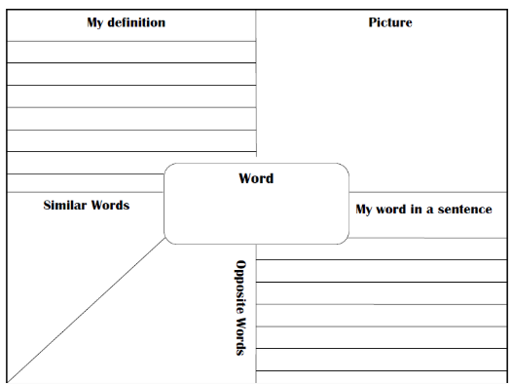
Retrieval Practice – complete the Frayer model with one of the emotions.
WALT: Use present perfect forms to express recent, indefinite and unfinished past.
happy
nervous
angry
scared
excited
interested

Slide 4
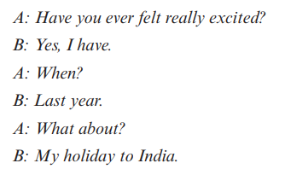
Starter – Have you ever felt…? When? What about?
WALT: Use present perfect forms to express recent, indefinite and unfinished past.
Use some the emotions we have discussed to ask your partner the question above.

Slide 5
Today we are looking at the present perfect tense. We use the present perfect tense to describe events in the recent past, when the time of the event is not important.
WALT: Use present perfect forms to express recent, indefinite and unfinished past.

Slide 6
WALT: Use present perfect forms to express recent, indefinite and unfinished past.
I have been on holiday to Bali.
past participle
have / has

Slide 7
WALT: Use present perfect forms to express recent, indefinite and unfinished past.
I have went on holiday to Bali.
Why would I not use ‘went’ in this sentence?
Because the present perfect needs the past participle not the past simple verb.

Slide 8
WALT: Use present perfect forms to express recent, indefinite and unfinished past.
Thinking of emotions, what sentences could we say using the present perfect tense?
Remember: have/has + past participle
Notes:
Recently, I have felt overwhelmed with the amount of work I need to do.

Slide 9
WALT: Use present perfect forms to express recent, indefinite and unfinished past.
Check your understanding
Which sentences are in the present perfect tense?
She has never experienced such an intense excitement until starting her new job.
Mr. Charlie loves to play golf on the weekend.
I was nervous to start Grade 5 because of the Checkpoints.
I have drawn a sunflower as it makes me feel warm inside.
Notes:
Recently, I have felt overwhelmed with the amount of work I need to do.

Slide 10
WALT: Use present perfect forms to express recent, indefinite and unfinished past.
Which sentences are in the present perfect tense?
She has never experienced such an intense excitement until starting her new job.
Mr. Charlie loves to play golf on the weekend.
I was nervous to start Grade 5 because of the Checkpoints.
I have drawn a sunflower as it makes me feel warm inside.
Notes:
Recently, I have felt overwhelmed with the amount of work I need to do.

Slide 11
WALT: Use present perfect forms to express recent, indefinite and unfinished past.
How could I change this sentence into the present perfect tense?
Mr. Charlie loves to play golf on the weekend.
Notes:
Recently, I have felt overwhelmed with the amount of work I need to do.

Slide 12
WALT: Use present perfect forms to express recent, indefinite and unfinished past.
Check your understanding
How could I change this sentence into the present perfect tense?
I was nervous to start Grade 5 because of the Checkpoints.
Notes:
Recently, I have felt overwhelmed with the amount of work I need to do.

Slide 13
WALT: Use present perfect forms to express recent, indefinite and unfinished past.
Have you ever...?
I have never…
They have never…
We have never…
He has never…
She has never…
Ms. Colette has never…
I have …
They have …
We have …
He has …
She has …
Ms. Colette has …

Slide 14
WALT: Use present perfect forms to express recent, indefinite and unfinished past.
Check your understanding!
Which of the sentences is written in the present perfect tense?
He went to Thailand.
She has eaten her breakfast already.
Which word should go in the gaps in these sentences?
He ______ been there before.
I’ve _______ that movie before.
Say a sentence to your partner in the present perfect form.
Give your partner some feedback on their sentence.

Slide 15
WALT: Use present perfect forms to express recent, indefinite and unfinished past.
Check your understanding!
Which of the sentences is written in the present perfect tense?
He went to Thailand.
She has eaten her breakfast already.
Which word should go in the gaps in these sentences?
He ______ been there before.
I’ve _______ that movie before.
has
seen
Say a sentence to your partner in the present perfect form.
Give your partner some feedback on their sentence.

Slide 16
WALT: Use present perfect forms to express recent, indefinite and unfinished past.
Your Task
In your notebook copy down the sentences written in the present perfect tense.
Have you ever ridden a horse?
I have never climbed a tree.
I wrote that I felt sad.
She has watched all the Star Wars films.
Change the sentences to make them the present perfect tense.
She visited Paris twice to see the Mona Lisa.
They finished their project on children’s emotions in Grade 5.
Ms. Colette went on holiday to Cambodia to see Angkor Wat.
I am worried because I lost my keys.
Write 4 sentences of your own using the present perfect tense.

Slide 17
WALT: Use present perfect forms to express recent, indefinite and unfinished past.
I can recognise the present perfect tense.
I can change sentences to the present perfect tense.
I can write sentences in the present perfect tense.

Slide 18
Plenary – What is wrong with this sentence?
WALT: Use present perfect forms to express recent, indefinite and unfinished past.
I have listened to that song last week.

